Slide 1
Discussion on Mental Health at USACE Norfolk District
General Mental Health, Depression, and Resources
Prepared by Miguel Lopez Rivera
For Navigation Support and Survey Section
4 January 2021

Slide 2
Outline
Mental Health
In General
Resources
Corps
Depression
Seasonal
Non-Corps
Tips for Success
Easy
Hard

Slide 3
Mental Health in General
Definition: a medical condition that disrupt a person's thinking, feeling, mood, ability to relate to others, and daily functioning – NAMI
Treatable
“Approximately 1 in 4 adults experience a mental health impairment” – JAN (DoL ODEP)
Notes:
Job Accommodation Network | US Department of Labor | Office of Disability Employment Policy
National Alliance on Mental Illness

Slide 4
Depression (Major Depressive Disorder)
Definition: a common and serious medical illness that negatively affects how you feel, the way you think and how you act. -APA
Treatable. Can lead to emotional and physical problems. Can decrease a person’s ability to function.
Affects an estimated 1 in 15 adults a year. -APA
And one in six people (16.6%) will experience depression at some time in their life. -APA
Notes:
Typically most common in the late teens and early 20’s

Slide 5
Seasonal Affective Disorder (SAD)
Definition: A biological imbalance due to less daylight in winter. Consists of mood changes and symptoms similar to depression. –APA
Treatable.
Tends to be most difficult in January and February.
Typically lasts about 40 percent of the year.
We have a whole other presentation just for this. (ask)
Notes:
Affects about 1 in 20 adults. (although I cannot find the source again)

Slide 6
Wake Up!
New slide incoming!

Slide 7
Do you know all the different mental Health Professionals?
Psychiatrist - A psychiatrist is a medical doctor (an M.D. or D.O.) who specializes in mental health. Psychiatry is a branch of medicine therefore; this is the only professional that can prescribe medication.
LCSW - Uses researched based strengths based social work approach to treating clients.
The Licensed Professional Counselor (LPC) or Licensed Mental Health Counselor (LMHC) are two different titles for essentially the same occupation in the mental health field, both of which require a significant degree of education as well as training.

Slide 8




Tips for Success : Easy Things
Volunteer
Stay socialized
Do not blame yourself
Talk about it
Stay Active
Postpone major decisions
Take care of your health
Avoid alcohol and drugs
Maintain a daily routine (Hard?)
Try new things
Eat a healthy diet
Try to sleep well
Watch something funny (TickTock!)
Education

Slide 9
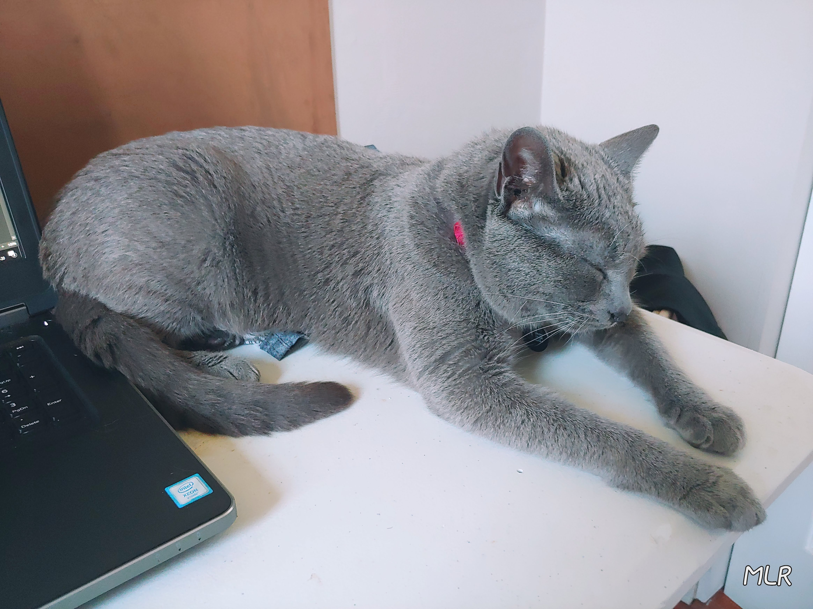
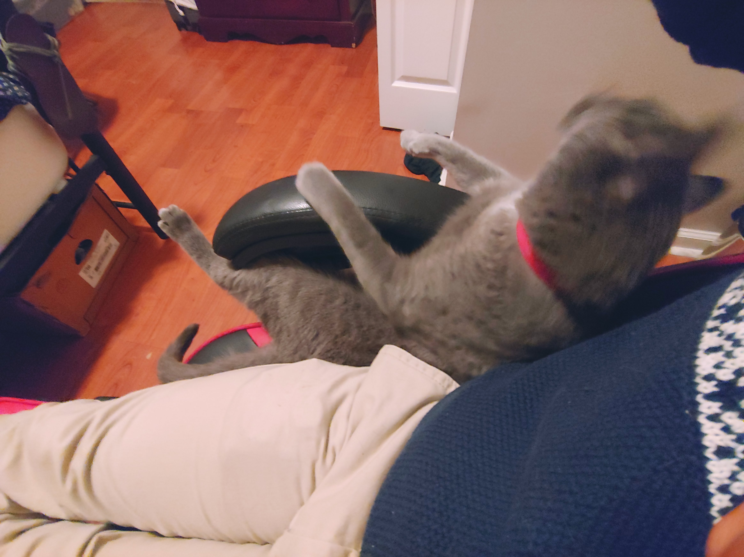

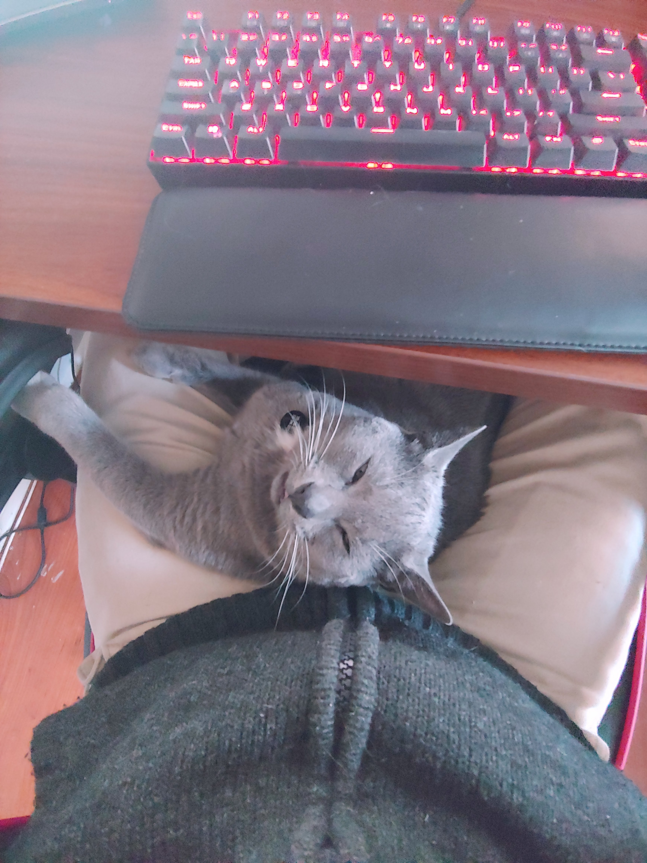
Tips for Success : Hard Things
Avoid Criticality
Do not isolate yourself 😒
Do not punish yourself for feeling bad
Do things you used to like doing
Join a support group
Care for a pet
See a therapist
Cognitive Behavioral Therapy
Medication
Electroconvulsive therapy

Slide 10
Resources at NAO
 | Website | Phone | Notes
EAP | www.FOH4You.com | 800-222-0364 800-262-7848 TTY | 24/7 General Help (Financial, Legal, Work Family, substance Abuse etc.)
myBHS (EAP) | portal.BHSonline.com | 800-327-2251 TTY | Username: USACE Confidential Counseling
USACE Critical Incident Stress Team |  | 314-925-5250 | Line-of-duty death or injury; employee suicide; drowning, near death experiences etc. Provide “emotional first-aid”
USACE Chaplain | https://www.usace.army.mil/contact.aspx | 202-761-7194 (Office) 202-761-0772 | Counseling. Work and faith.
Let me know if this needs updating!

Slide 11
Resources Outside NAO
 | Website | Phone | Notes
Suicide Prevention Lifeline | www.suicidepreventionlifeline.org | 800-273-TALK (8255) Text: 838255 1-800-799-4889 (Hearing Impaired) | This national hotline is a valuable resource for people whose depression has escalated to suicidal or other harmful thoughts. Their network of crisis centers provide emotional support and guidance to people in distress and are also available via a chat service.
Crisis Text Line | www.crisistextline.org | Text Home to 741741 | Free 24/7 crisis support in the US
National Hopeline Network | www.imalive.org/ | 1-800-SUICIDE (784-2433) | If your depression is leading to suicidal thoughts, call the National Hopeline to connect with a depression treatment center in your area. The Hopeline also offers a live chat feature for those who don’t want to (or are unable to) call and can dispatch emergency crews to your location if necessary.
Substance Abuse and Mental Health Services Administration (SAMHSA) | https://findtreatment.samhsa.gov/ | 1-800-662-HELP (4357) | SAMHSA’s behavioral health treatment services locator is an easy and anonymous way to locate treatment facilities and other resources, such as support groups and counselors, to treat and manage depression.

Slide 12
Questions? Comments?

Slide 13
Thank you!

Slide 14
References
https://askjan.org/disabilities/Mental-Health-Impairments.cfm
https://askjan.org/disabilities/Depression.cfm
https://askjan.org/a-to-z.cfm
https://www.mayoclinic.org/diseases-conditions/depression/symptoms-causes/syc-20356007
https://suicidepreventionlifeline.org/

